Slide 1
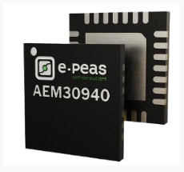
Power Management ICs
➢ Energy-harvesting PMIC comparison
Cold-start capability | Regulated outputs | Conversion efficiency
Device
Cold-Start Input
Regulated Outputs
Efficiency
e-peas DS-AEM30940
380 mV at 3 µW
1.2/1.8 V LV LDO
1.8-4.1 V HV LDO
80-90%
Texas Instruments BQ25505
≥ 600 mV
2.0-5.5 V battery output
80-90%
Linear Technology LTC3108-1
20 mV
2.5/3.0/3.7/4.5 V VOUT
2.2 V LDO
30%
80-90% ranges plotted at their midpoint.
Key integration advantage
Dual regulated LDO outputs
The selected AEM30940 combines 80-90% reported efficiency with separate low- and high-voltage rails.
e-peas AEM30940
Selected PMIC: DS-AEM30940

